Slide 1

Real-time Image Vectorization on GPU
Xiaoliang Xiong, Jie Feng, Bingfeng Zhou
Institute of Computer Science and Technology, Peking University, China
Notes:
In this work, we propose a novel algorithm to vectorize the silhouettes in the color image and adopt graphics hardware to accelerate the calculation to achieve real time performance.

Slide 2




Introduction
Image Representation
Raster form
Vector form
Use a large pixel matrix
Require much more space
Rendered with high efficiency
Suffer seriously from aliasing or loss of details when scaled
Use geometry primitives, more compact in representation
Require less space to store
Convenient to transmit and edit
Artifact-free in display
Notes:
We know, images are basically represented in two forms: the raster form and the vector form. In our daily life, images taken by our phone and camera are in raster form. These images use …1…2…3…4.
On the contrary, vector images 1,2,3,4. The advantages of vector image over raster image
Make it widely used in mobile and Internet computing, and several practical applications.

Slide 3
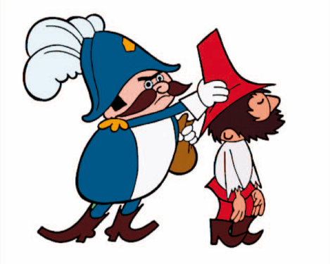
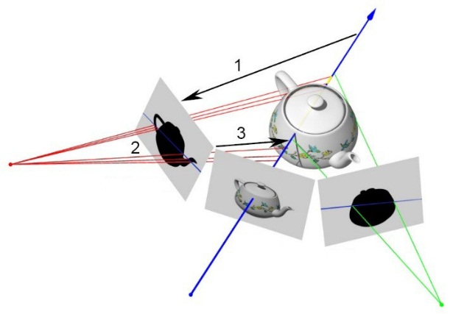
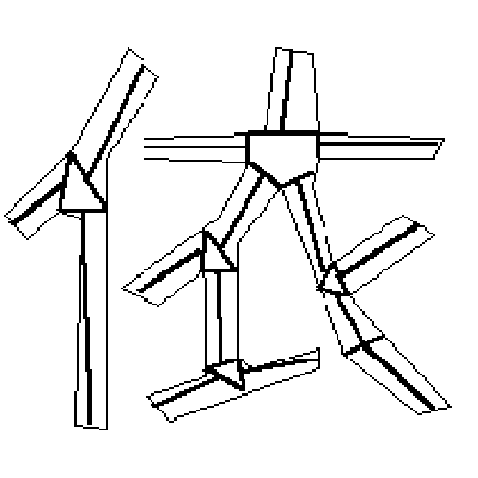
Introduction
Cartoon Animation
Shape From Silhouette
Document Image
Processing
Convert a raster key frame into its vector form
Generate in-betweens by shape matching and interpolation
Estimating 3D shape of an object from its silhouette images
Visual Hull
Visual cones intersection
Converting the text on image into features the computer can recognize
Skeletons
Contours
[Zou and Yan, 2001]
[Zhang et al., 2009]
[Laurentini, 1994]
[Matusik et al., 2000]
[Chang et al., 1999]
[Smith, 1987]
Notes:
Image vectorization in application
Specifically, here we list three typical applications.
Traditionally, cartoons are drawn by the artists frame by frame, which is labor intensive. Nowadays, only the key frames need to be drawn, and then converted into vector form. The in-betweens are generated by shape matching and interpolation automatically.
The second: SFS is a technique of estimating 3d shape of an object from its sil images. One famous algorithm is the visual hull. The 3D shape is computed by intersecting the visual cones from different viewpoints. The silhouette in the computing is in its vector from.
The third: Document image processing tends to convert the text on image into features that the computer can recognize. These features include skeleton and contour.

Slide 4
Motivation
Shape From Silhouette
  Silhouettes are approximated by line segments
  Conversion from pixels to line segments
  Originally a vectorization problem
Notes:
The most straightforward motivation of this work is the SFS. AS I have just mentioned, in SFS computing, the visual cones are composed of viewing rays emanating from the camera center and passing though the silhouette from each viewpoint. To improve the efficiency, the silhouettes are approximated by line segments instead of pixels. And the conversion from pixels to line segments is originally a vectorization problem.

Slide 5
Motivation
Shape From Silhouette
  Silhouettes are approximated by line segments
  Conversion from pixels to line segments
  Originally a vectorization problem

Slide 6
Motivation
Shape From Silhouette
  Silhouettes are approximated by line segments
  Conversion from pixels to line segments
  Originally a vectorization problem
Accelerate vectorization to achieve dynamic visual hull rendering
Distribute vectorization onto GPU
Notes:
To achieve dynamic vh performance, the vectorization should be accelerated. We adopt graphics hardware to do the acceleration.

Slide 7
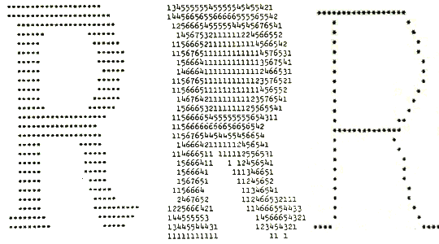
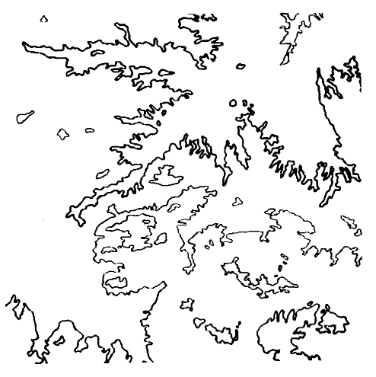
Related Work: Vectorization
Crude Vectorization
  Representing the original image with primary geometry like skeleton and contour polygon
Thinning based methods
Non-thinning based methods
  [Smith, 1987]
  [Jimenez and Navalon, 1982]
Notes:
Vectorization is a longstanding hot topic in computer graphics. Here we summerize the vectorization technique into two catogaries: Crude vect on gray images& advanced vect on color images.
The former tends to represent the raster image with primary geometry primitives like lines, polygons. Crude vectorization is often divided into two classes: Thinning based & nonthinning based.
Thinning based methods erosion the original image iterarively until a skeleton is left. Obviously, the width information of the character is lost as shown in this example.
Nonthinning based methods represent the image with contours.

Slide 8
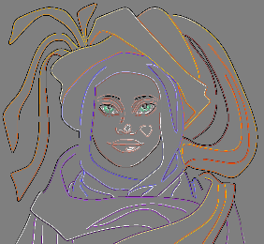

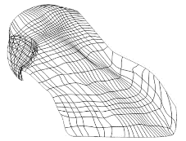
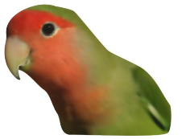
Related Work: Vectorization
Advanced vectorization
  Accurate approximation for both sharp and smooth features
  Constructing high-quality vector representation with less geometry primitives
Triangle mesh based methods
Points sampling
Triangulation
Diffusion curve based methods
Detect the edges
Convert into diffusion curves
Gradient mesh based methods
Generate gradient mesh
Semi-automatic
[Zhao et al., 2013, Xia et al., 2009]
  [Orzan et al., 2013]
  [Sun et al.,2009]
Notes:
For advanced vectorization, these methods want to represent both the sharp and smooth features in the original image with compact geometry primitives.
There are three commonly used primitives: triangle mesh, diffusion curve and gradient mesh.
Triangle mesh based methods first sample important points on the raster image, then triangulate the image based on these points. The color information is stored on the triangle vertex.
Diffusion curve based methods first detect the edges exist in the raster image, which are then converted into diffusion curves. The color information is stored on these curves.
Gradient mesh based methods first generate the gradient mesh based on the texture of the raster image, and some of them need human interaction.

Slide 9
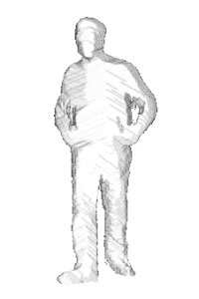
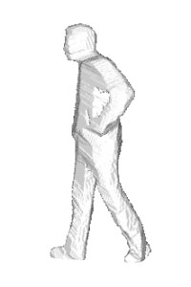
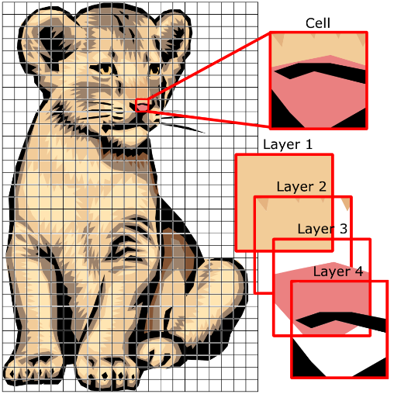
Related Work: GPU-acceleration
GPU-based Shape From Silhouette
Visual hull parallelization
Vectorized Image Rendering
High efficiency rendering
[Ladikos et al., 2008]
[Waizenegger et al. 2009]
[Yous et al., 2007]
[Nehab and Hoppe, 2008]
[Xia et al., 2009]
[Orzan et al., 2013]
Notes:
Graphics hardware is widely used in vectorization and its related applications. For SFS, GPU is adopted to do the vh computation. But when the VH is dynamic, the silhouette vectorization can not keep in pace with vh rendering so that it should be accelerated.
There are also several researches on vectorized image rendering, but not for vectorization problem.

Slide 10
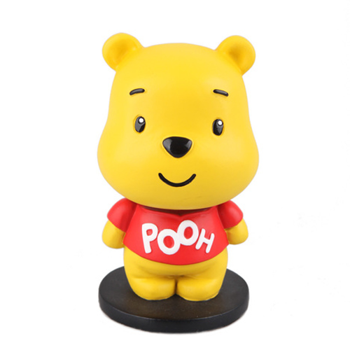

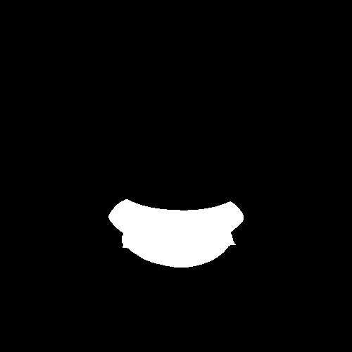


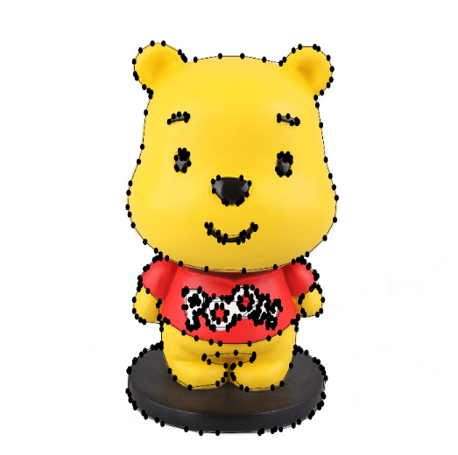
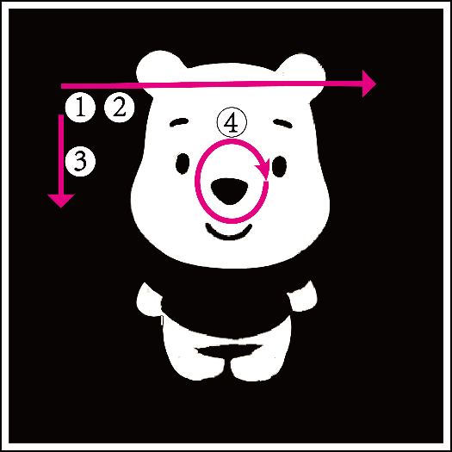
Overview
Thresholding
Input raster image
Binary silhouettes
Boundary detecting
Preontouring
Contouring
Contour Vectorization
Vectorization result
Silhouettes vectorization
Notes:
This is the overview of our method, with an input raster image, we first segment it into different parts and convert to binary silhouettes. In this example, we binarize the input image by thresholding. Then all these silhouette images are loaded into GPU to do the vectorization using our algorithm.
Finally, we get the vectorization result, with silhouettes represented by line semgents.

Slide 11
Our Algorithm
Input silhouette image
Boundary Pixel Detecting
  Like scanline filling
  Parallel between each line
  Each thread for one scanline
Notes:
First of all, the boundary pixels should be detected, we take the idea from scanline algorithm in polygon filling, so that each line can be processed simutanously.

Slide 12

















Algorithm
Boundary Pixel Detecting
$$s_{i}=\{R_{k}^{\left(i\right)}|R_{k}^{\left(i\right)}=\left(I_{k},O_{k}\right),I_{k}<O_{k}, 1≤k≤N_{i}\}$$
Interval: $\left(I_{k},O_{k}\right)$
$$I_{1}^{i_{0}}$$
$$O_{1}^{i_{0}}$$
$$I_{2}^{i_{0}}$$
$$O_{2}^{i_{0}}$$
$$I_{3}^{i_{0}}$$
$$O_{3}^{i_{0}}$$
$$\hat{s_{i_{0}}}$$
3 intervals
$$\hat{s_{i_{1}}}$$
4 intervals
$$I_{1}^{i_{1}}$$
$$O_{1}^{i_{1}}$$
$$I_{2}^{i_{1}}$$
$$O_{2}^{i_{1}}$$
$$I_{3}^{i_{1}}$$
$$O_{3}^{i_{1}}$$
$$I_{4}^{i_{1}}$$
$$O_{4}^{i_{1}}$$
Notes:
During scanning, the pixel enters background into foreground is donated as Ik, and leaves foreground into background is donated ad Ok.

Slide 13
Algorithm
Boundary Pixel Detecting
Pre-contouring
  Compute connectivity relationship
  between adjacent lines
  Parallel between each two scanlines
Notes:
Next, the connectivity relationship between each line should be computed. It is a preparation of contour so we call it pre-contouring. Because the boundary are only directly connected between adjacent line, so the precontouring concerns the boundary pixel relationship between each two adjacent lines.

Slide 14




























Algorithm
Boundary Pixel Detecting
Pre-contouring
  Connectivity relationship
$$I^{i_{0}}$$
$$O^{i_{0}}$$
0
1
1
0
$$I^{i_{1}}$$
$$O^{i_{1}}$$
$$I^{i_{0}}$$
$$O^{i_{0}}$$
$$I_{1}^{i_{0}}$$
$$O_{1}^{i_{0}}$$
$$I_{n}^{i_{0}}$$
$$O_{n}^{i_{0}}$$
1
1
n
1
$$I^{i_{1}}$$
$$O^{i_{1}}$$
$$I^{i_{1}}$$
$$O^{i_{1}}$$
$$I^{i_{0}}$$
$$O^{i_{0}}$$
$$I_{1}^{i_{0}}$$
$$O_{1}^{i_{0}}$$
$$I_{n}^{i_{0}}$$
$$O_{n}^{i_{0}}$$
1
n
m
n
$$I_{1}^{i_{1}}$$
$$O_{1}^{i_{1}}$$
$$I_{n}^{i_{1}}$$
$$O_{n}^{i_{1}}$$
$$I_{1}^{i_{1}}$$
$$O_{1}^{i_{1}}$$
$$I_{m}^{i_{1}}$$
$$O_{m}^{i_{1}}$$
Notes:
Intuitively, the relationship between each two lines can be summarized into four cases: 1:1, 1:n, n:1, n:N. And two special cases: 1:0, 0:1

Slide 15


















Algorithm
Boundary Pixel Detecting
Pre-contouring
$$I_{1}^{i_{0}}$$
$$O_{1}^{i_{0}}$$
$$I_{2}^{i_{0}}$$
$$O_{2}^{i_{0}}$$
$$I_{3}^{i_{0}}$$
$$O_{3}^{i_{0}}$$
$$\hat{s_{i_{0}}}$$
$$\hat{s_{i_{1}}}$$
$$I_{1}^{i_{1}}$$
$$O_{1}^{i_{1}}$$
$$I_{2}^{i_{1}}$$
$$O_{2}^{i_{1}}$$
$$I_{3}^{i_{1}}$$
$$O_{3}^{i_{1}}$$
$$I_{4}^{i_{1}}$$
$$O_{4}^{i_{1}}$$
Segment #1:
$|R_{1}^{\left(i_{0}\right)}$|:$|R_{1}^{\left(i_{1}\right)}$|=1:1
Segment #2:
$|R_{2}^{\left(i_{1}\right)}$|:$|R_{2}^{\left(i_{0}\right)}$|=3:2

Slide 16
Algorithm
Boundary Pixel Detecting
Pre-contouring
Contouring
Notes:
Up to now, the boundary pixels are detected and pre-contoured in parallel. We get the foreground intervals and their connectivity relationship between adjacent lines. With these information, we can organize the boundary pixels into loops.

Slide 17




























Contouring rules
Loop Initialization(1:0)
Loop Termination(0:1)
$$I^{i_{0}}$$
$$O^{i_{0}}$$
$$I^{i_{1}}$$
$$O^{i_{1}}$$
Loop Extension(1:1)
Loop Merging(1:n)
$$I^{i_{0}}$$
$$O^{i_{0}}$$
$$I_{1}^{i_{0}}$$
$$O_{1}^{i_{0}}$$
$$I_{n}^{i_{0}}$$
$$O_{n}^{i_{0}}$$
$$I^{i_{1}}$$
$$O^{i_{1}}$$
$$I^{i_{1}}$$
$$O^{i_{1}}$$
Loop Branching(n:1)
Loop Merging, then Branching(m:n)
$$I^{i_{0}}$$
$$O^{i_{0}}$$
$$I_{1}^{i_{0}}$$
$$O_{1}^{i_{0}}$$
$$I_{n}^{i_{0}}$$
$$O_{n}^{i_{0}}$$
$$I_{1}^{i_{1}}$$
$$O_{1}^{i_{1}}$$
$$I_{n}^{i_{1}}$$
$$O_{n}^{i_{1}}$$
$$I_{1}^{i_{1}}$$
$$O_{1}^{i_{1}}$$
$$I_{m}^{i_{1}}$$
$$O_{m}^{i_{1}}$$
Notes:
Here we list the contouring rules according to the connectivity relationship.

Slide 18
Algorithm
Boundary Pixel Detecting
Pre-contouring
Contouring
Loop Initialization

Slide 19
Algorithm
Boundary Pixel Detecting
Pre-contouring
Contouring
Loop extension

Slide 20
Algorithm
Boundary Pixel Detecting
Pre-contouring
Contouring
Loop extension

Slide 21
Algorithm
Boundary Pixel Detecting
Pre-contouring
Contouring
Loop extension

Slide 22
Algorithm
Boundary Pixel Detecting
Pre-contouring
Contouring
Loop extension

Slide 23
Algorithm
Boundary Pixel Detecting
Pre-contouring
Contouring
Loop termination
Note: Loop branching and merging do not appear in this demo.
Notes:
When all lines of silhouette images are processed, target loops are generated.

Slide 24
Algorithm
Boundary Pixel Detecting
Pre-contouring
Contouring
Contour vectorization
  Approximate the contour by line segments
  Active Contour Modeling [Kass et al., 1988]

Slide 25

Algorithm
p₁
p_{M}
Boundary Pixel Detecting
Pre-contouring
Contouring
Contour vectorization
  $$L=p_{1}p_{2}…p_{i}{…p}_{M−1}p_{M}$$
  $$d=max⁡\{dist(p_{i},\vec{p_{1}p_{M}})\}$$
p₂
p_{i}

Slide 26
Algorithm
Boundary Pixel Detecting
Pre-contouring
Contouring
Contour vectorization

Slide 27
Experiment & Result
Implement our algorithm using CUDA
Common PC with Quad CPU 2.5GHz, 2.75GB RAM
GeForce GTX260+ graphic card
Boundary Detection, Pre-contouring, Contour Vectorization are parallelized onto GPU

Slide 28

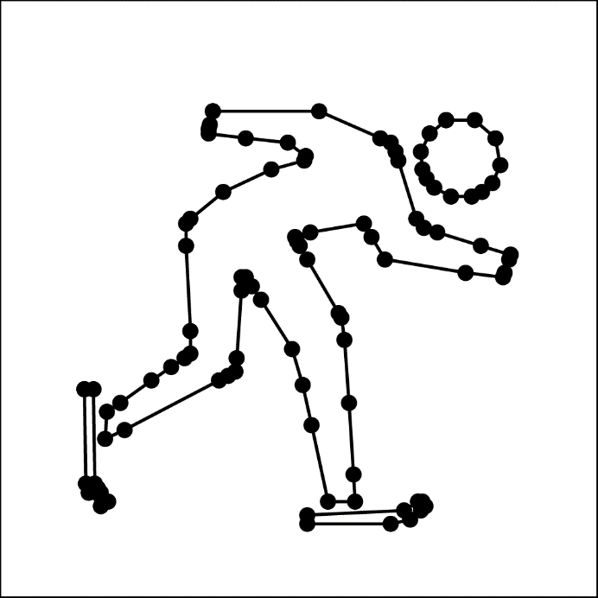
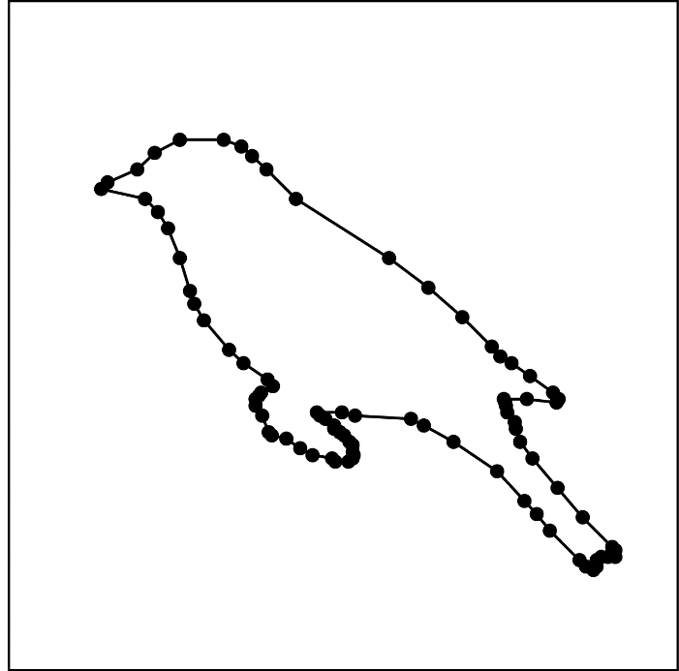
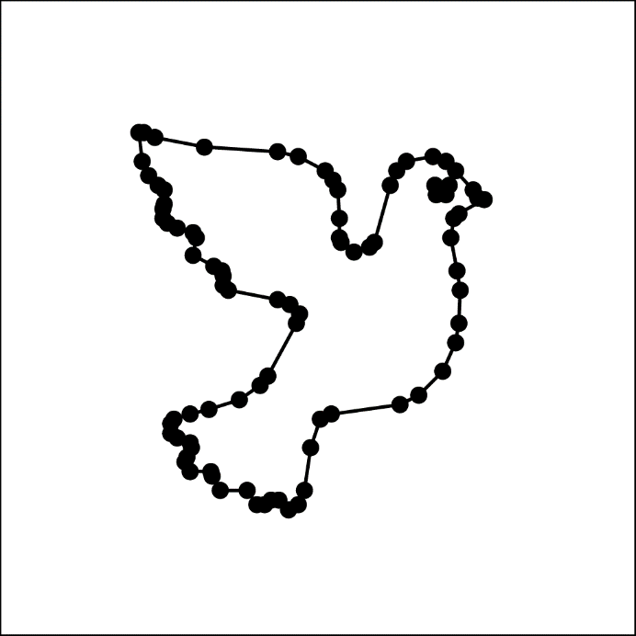




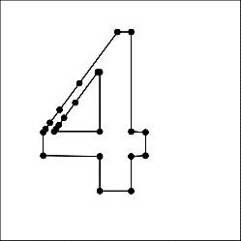
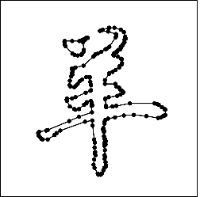
Result
Character Vectorization

Slide 29
Evaluation
Image | Resolution | #Points | #edges | #loops | Time(ms)
CharB | 600x600 | 626 | 84 | 3 | 6.51
Digit4 | 600x600 | 414 | 24 | 2 | 5.93
Pegion | 400x400 | 439 | 86 | 2 | 5.89
Skater | 400x400 | 596 | 104 | 4 | 6.56
Bird | 600x480 | 833 | 83 | 1 | 8.92
Yang | 600x480 | 982 | 203 | 2 | 9.75
Winnie | 500x500 | 2761 | 432 | 26 | 8.54

Slide 30
Comparison
Floodfill-based method vs our method
Difference: strategy of boundary pixel detection and ordering
 |  | 200² | 400² | 600² | 800² | 1000²
Pigeon | FBM | 29.9 | 105.4 | 306.4 | 510.1 | 799.8
 | Ours | 4.6 | 7.6 | 7.8 | 9.7 | 13.1
Skater | FBM | 18.8 | 67.6 | 168 | 293.5 | 420.8
 | Ours | 5.6 | 7.7 | 8.5 | 11.6 | 14.2
Bird | FBM | 14.5 | 90.5 | 158.3 | 419.9 | 583.3
 | Ours | 4.9 | 6.5 | 8.1 | 11.2 | 14.1

Slide 31
Application

Slide 32

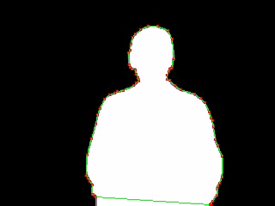
Video Vectorization
Silhouettes are extracted by background subtraction
Temporal coherence is not considered
Average frame rate: 48 fps

Slide 33
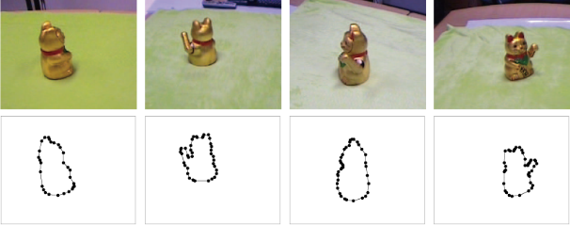
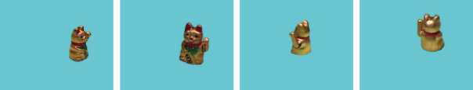
Visual Hull
Contour vectorization among 8-channel multi-view video streams
Temporal coherence is not considered
reconstruct and render dynamic VH 20 fps
Channel-1
Channel-2
Channel-3
…Channel-8
Input
video
Vecorized
silhouette
Frame sequence:
VHs

Slide 34
Document Image Vectorization
Large number of contours
Difficulties in data storing and transferring on GPU

Slide 35
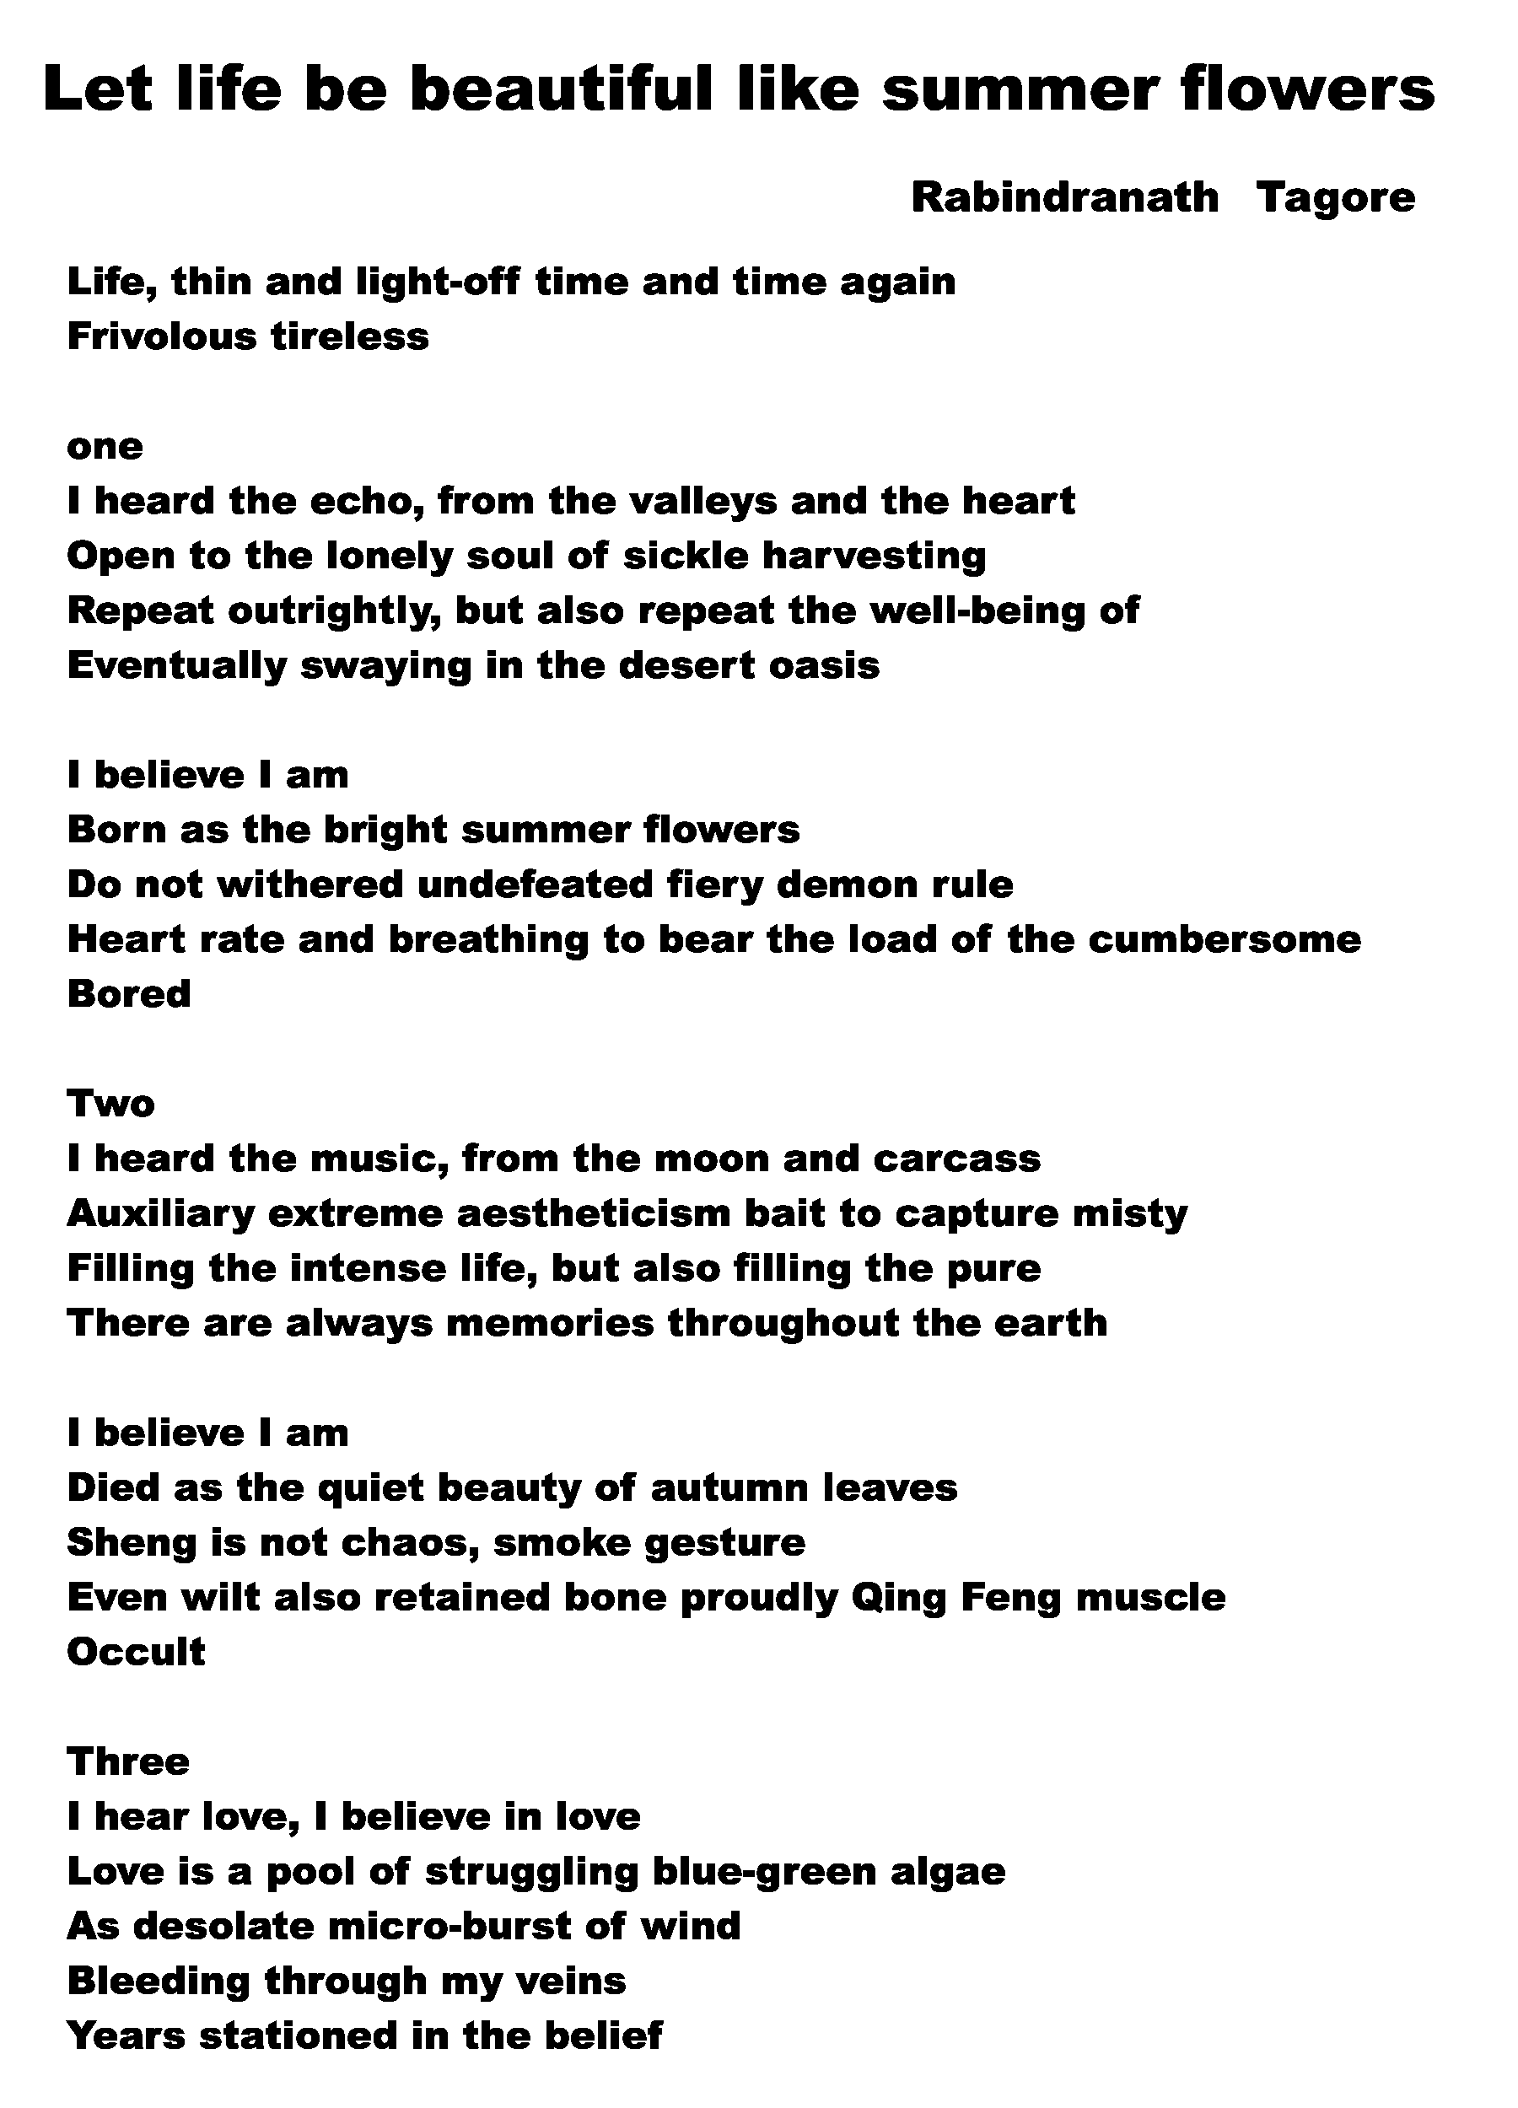
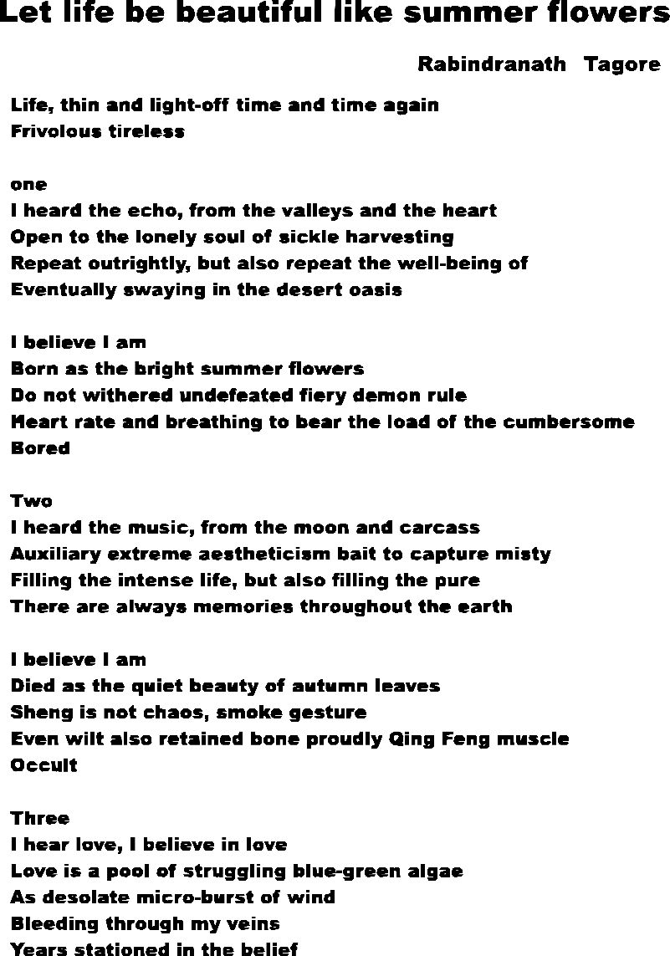
Document Image Vectorization
Input
Vectorization Result

Slide 36
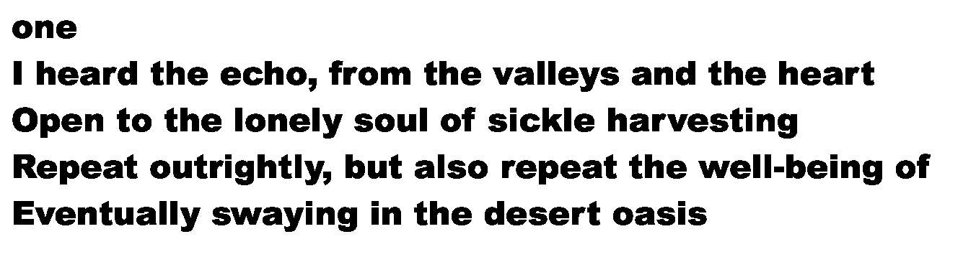


Slide 38



Slide 39

Real-time Image Vectorization on GPU
Xiaoliang Xiong, Jie Feng, Bingfeng Zhou
Institute of Computer Science and Technology, Peking University
Boundary Pixel Detecting
Pre-contouring
Contouring
Contour vectorization
Future work
  Parallelize the contouring step
  Postprocess the vectorization result
Contact info: {jonny_xiong, feng_jie, cczbf}@pku.edu.cn

