Slide 1
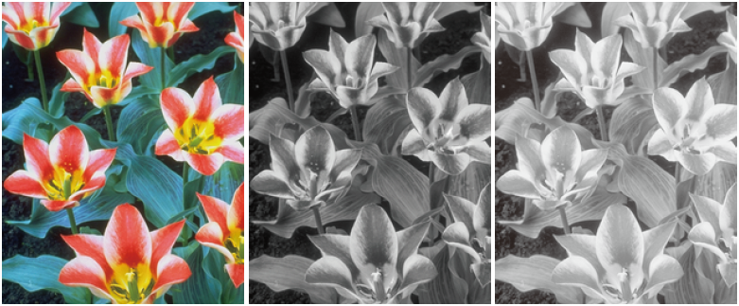
Automatic Color-to-Gray Conversion for Digital Images in Gradient Domain
Lu Hao, Jie Feng, Bingfeng Zhou
Institute of Computer Science and Technology
Peking University
Beijing, China

Slide 2
Outline
Motivation & Related Work
Color-difference-based Color-to-gray Conversion
Artifact Removal
Color Ordering for Isoluminance Image
Automatic Parameter Optimization
Experimental Results
Evaluation
Conclusion & Future Work

Slide 3
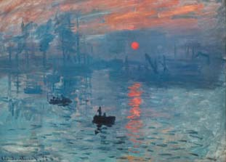
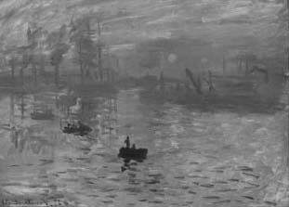
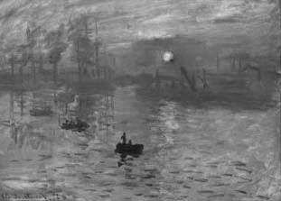
Motivation
Color-to-grayscale conversion for digital color images
Widely used in B&W printing, computational photography , video, animation, etc.
Preserving features in conversion
Ideal color-to-gray conversion algorithm
Coincide with the luminance vision of human eyes
L component of CIELAB (CIE 1976 (L*a*b*))
Keep discriminability of isoluminance colors
No artifacts be introduced into the grayscale image
Original image
L in CIELAB
Our result

Slide 4
Motivation
Current color-to-gray conversion methods
Linear combination of original color channels [Ohta and Robertson2005]
Lack of color discriminability for isoluminance colors
Global optimization [Gooch et al. 2005; Kim et al. 2009]
Very time-consuming
Local feature enhancement [Neumann et al. 2007; Smith et al. 2008]
Gray-scale distortion, e.g. “halo effect”
Our Color-difference-based conversion method
A gradient domain method
Enhancing luminance difference with the chromatic difference
Preserving salience of the original color image
Minimizing grayscale distortion
Keep correct color ordering for isoluminance colors

Slide 5


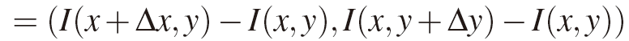
Gradient Domain Image Processing
I
∇I’
I’
∇I
PES
I
Grayscale image
Modified gradient field
New image
Gradient field
Reconstructed image
Grayscale image I : discretization of a continuous I(x,y) in R²
Gradient ∇I :
Reconstructing I from ∇I by a PDE solver
e.g. Poisson equation solver (PES)
By modifying ∇I, a different image can be obtained for certain purpose [Fattal et al. 2002; Perez et al. 2003; McCann and Pollard 2008]
For color-to-gray conversion
I = the luminance component of a color image (e.g. L of CIELAB)

Slide 6

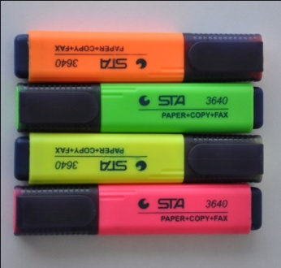
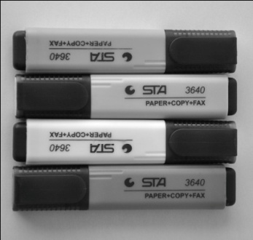
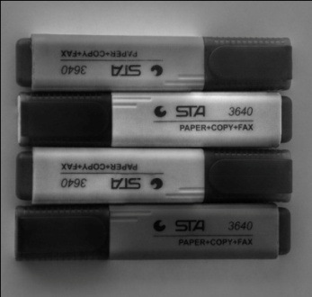
The Measurement of Color Difference
Using only L component in grayscale image reconstruction
Not coincide with the color difference that human eyes perceive
Defining color difference in CIELAB
CIELAB: visually uniform color space
Chromatic difference preserved as well
Perceptible grayscale distortion may occur
Original
L of CIELAB
Grayscale distortion using ∆E

Slide 7
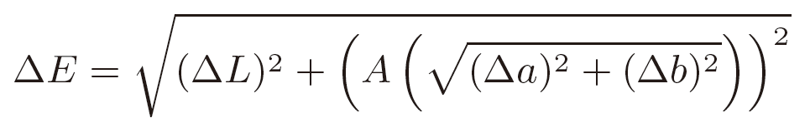
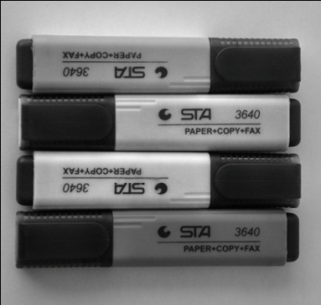
The Measurement of Color Difference
Our improvement:
Add a attenuation function A(·) to the chromatic difference
Grayscale distortion can be minimized
Original
L of CIELAB
Grayscale distortion using ∆E
Modulated chromatic difference

Slide 8




Color-difference-based Color-to-gray Conversion Framework
Luminance
component
Luminance
gradient
C
LAB
L
∇L
PES
G
G
PES
Color image
Grayscale image
Grayscale image
a
C_{x}
A
Enhancement
b
C_{y}
A
Attenuation function
Chromatic
component
Chromatic
gradient
L, a, b channels of the CIELAB model
A luminance gradient
A chromatic gradient
Modulated chromatic enhancement to the luminance gradient

Slide 9

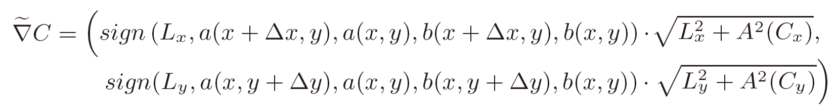
Color-difference-based Color-to-gray Conversion Framework
C
LAB
L
∇L
PES
G
Color image
Grayscale image
a
C_{x}
A
b
C_{y}
A
The enhanced gradient :
A(·): attenuation function for chromatic gradient, for artifact removal
sign(·): sign function of the gradient, for determining the color ordering
Grayscale image G reconstructed by a PES

Slide 10


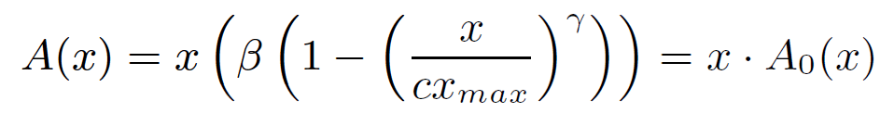
Artifact Removal
Creating new images with PES
Common problem: the existence of artifacts
Grayscale distortion in color-to-grayscale conversion
Employs multi-scale schema [Fattal et al. 2002]
Removes the inconsistency of the gradient field [Neumann et al. 2007]
Our solution
Single-scale method, fast and efficient
Selectively attenuate the gradient enhancement by an attenuation function A(·)

Slide 11
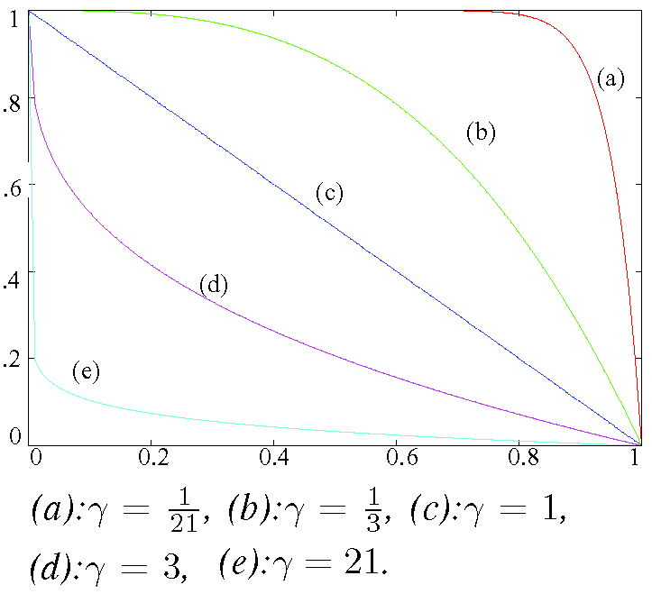
Artifact Removal
Attenuation function
Scales down the input signal by a scaling function A₀(·)
Works only on chromatic difference C_{x} and C_{y}
Enhancement to the luminance difference is always valid when β≠0

Slide 12
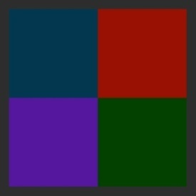

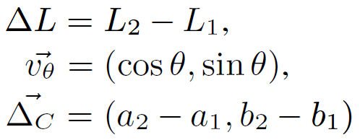


Color Ordering for Isoluminance Image
Isoluminance colors
Difficult to preserve the ordering in grayscale image
Defining sign function for the gradient field
As the sign of the luminance difference ∆L
Do not work for pixels with equal luminance
Our sign function sign(·)
For colors (L₁, a₁, b₁) and (L₂, a₂, b₂)
b
θ
a
Luminance difference
Chromatic difference
: affecting strength of the chromatic difference
: defines a direction in a-b plane

Slide 13
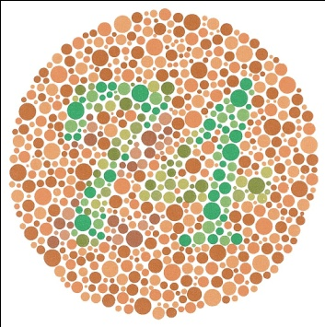
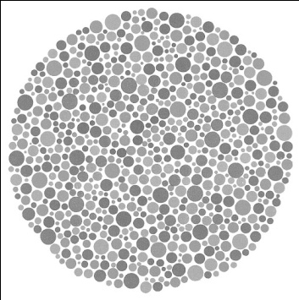
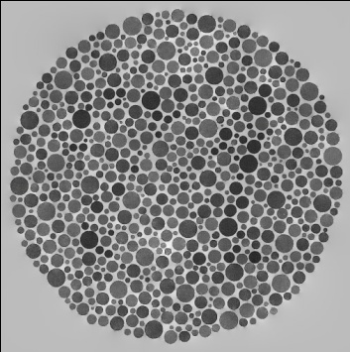
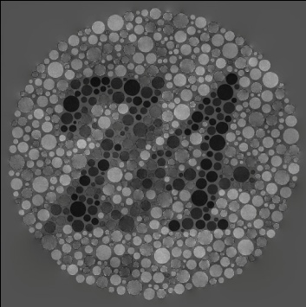
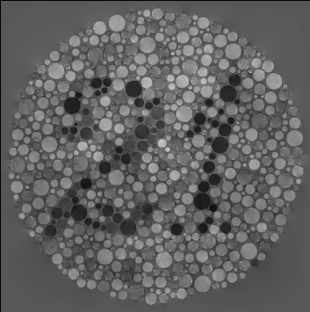
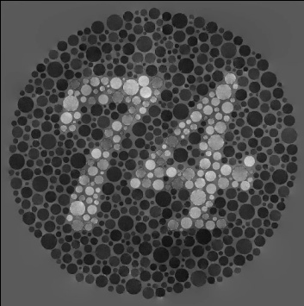
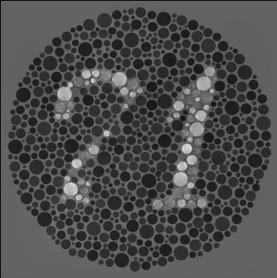
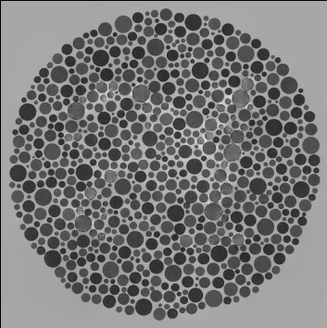
Color Ordering for Isoluminance Image
An example: color blindness testing chart
Chromatic color differences larger then luminance difference
Sign function with different θ reveals different pattern
Original
L in CIELAB
θ=0˚
θ=45˚
θ=90˚
θ=135˚
θ=180˚
θ=225˚

Slide 14
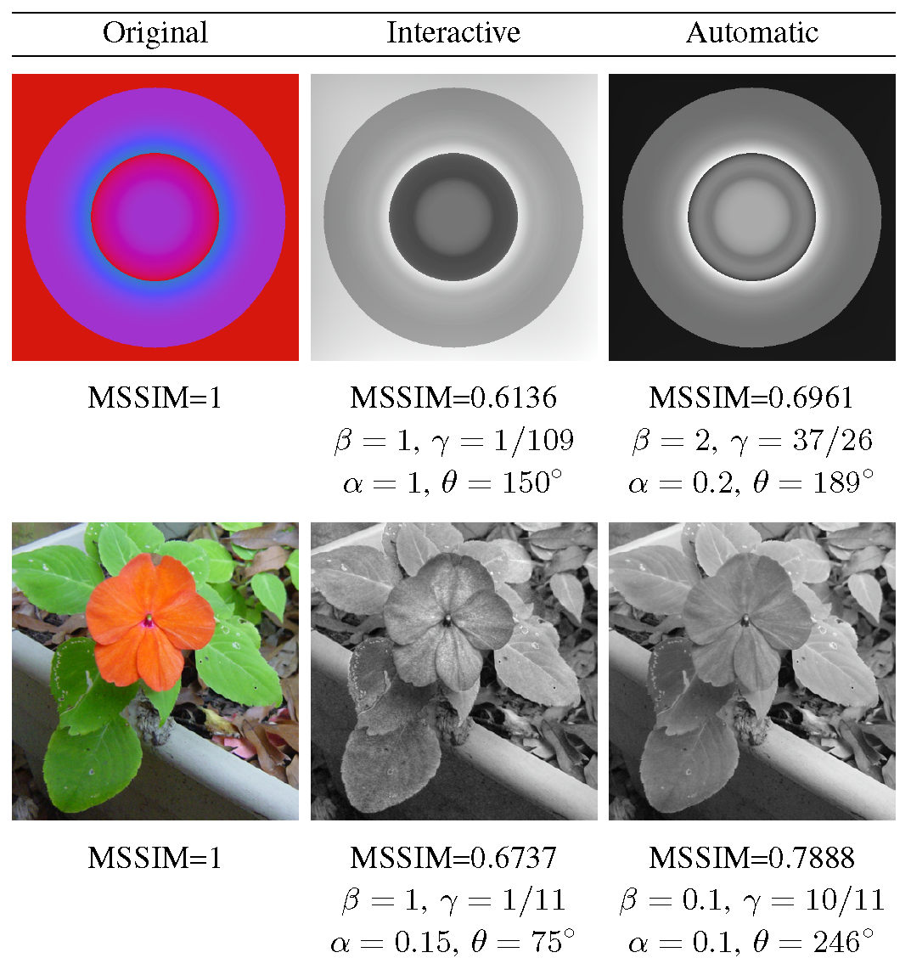
Automatic Color-to-Gray Conversion
Deciding 4 free parameters
α, β, γ and θ
Inappropriate parameters may result in grayscale distortions
Automatically finding optimal parameters
Choosing an optimization function
MSSIM: Mean Structural Similarity Index Measurement [Wang et al. 2004]

Slide 15
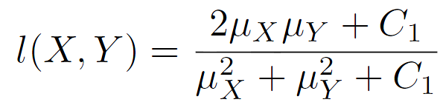
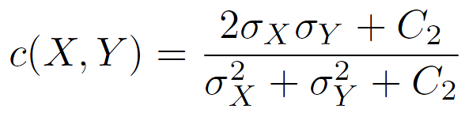


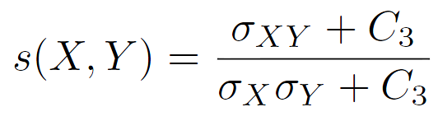

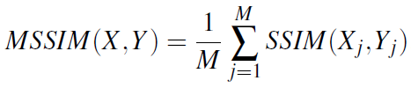
Automatic Color-to-Gray Conversion
SSIM: Structural Similarity Index Measurement
Works on a pair of 11x11 window X, Y
MSSIM: average SSIM for moving windows (X_{i}, Y_{j})
Luminance compare:
Contrast compare:
Structure compare:

Slide 16


Automatic Color-to-Gray Conversion
Our implementation for color images:
Parameter optimization problem:

Slide 17
Experiment Results
Implementation
Input RGB image → CIEXYZ → CIELAB
RGB color: PAL-RGB; reference white: D₆₅
Efficiency
Using a PES with linear time complexity [Press et al. 1992]
Steady execution speed
2 seconds per mega pixel (1024×1024 pixels in RGB)
Intel Core Dou CPU 2.2GHz and 2GB memory

Slide 18
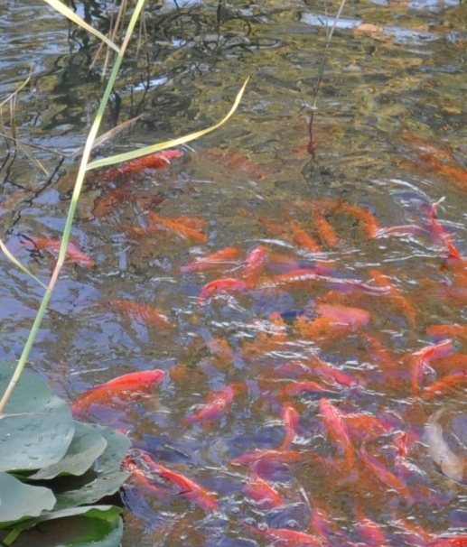
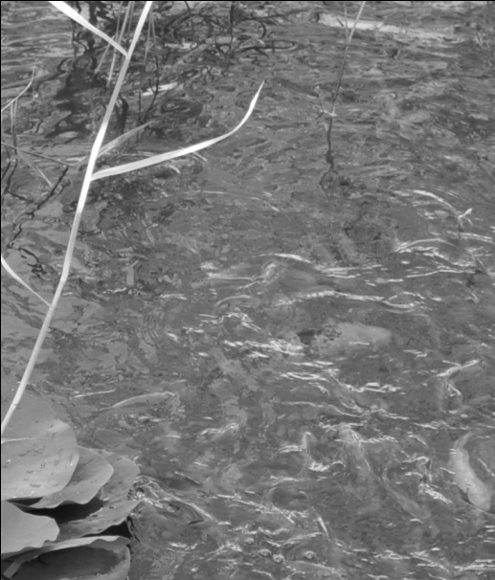
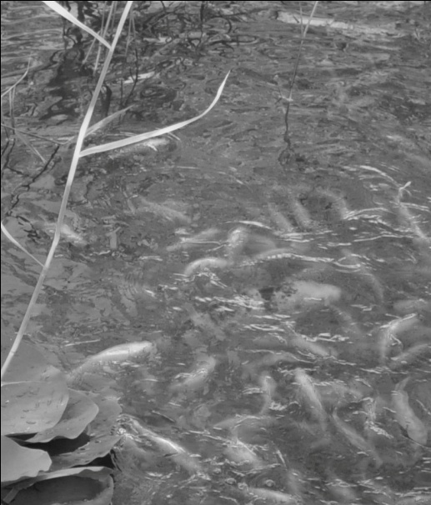
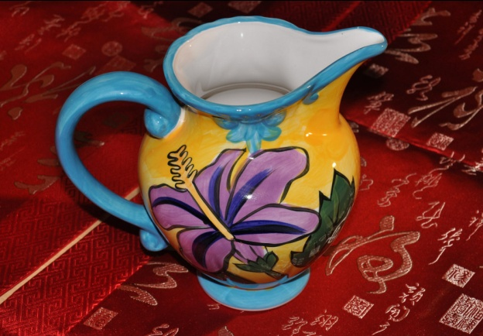
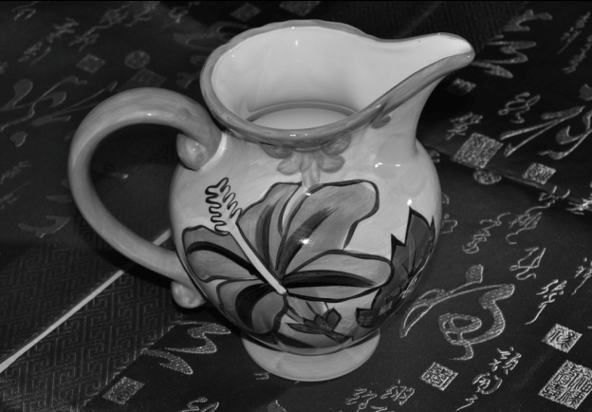
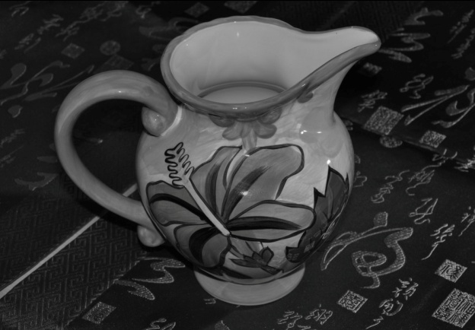


Experiment Results
Salience preserving
Satisfying salience-preserving ability
Preserve more details, visually closer to the original color image
Original
L of CIELAB
Our result
Original
L of CIELAB
Our result

Slide 19
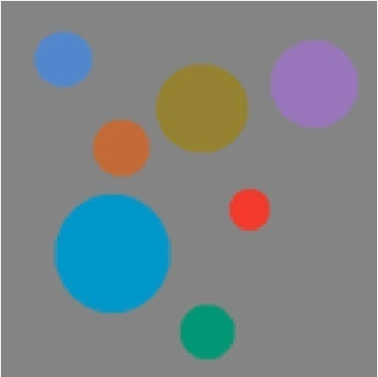


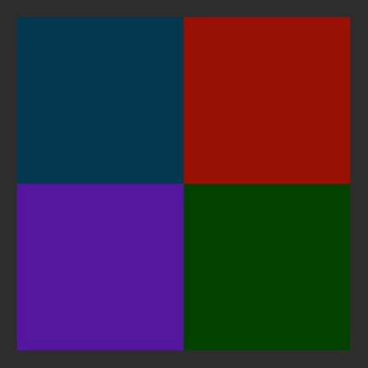


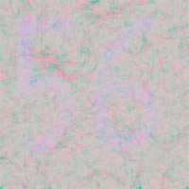
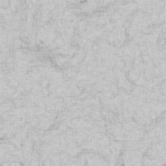
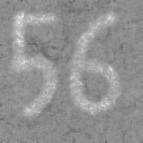
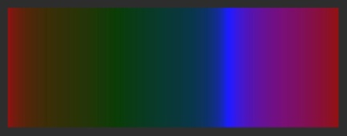


Experiment Results
Color discriminability
Perfect color discriminability and ordering for both continuous color and discrete color
Original
L of CIELAB
Our result
Original
L of CIELAB
Our result

Slide 20
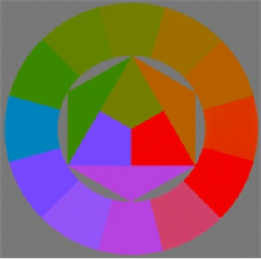
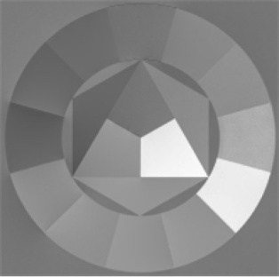
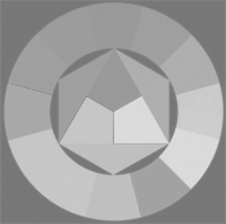
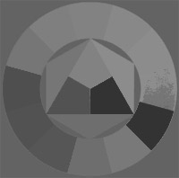
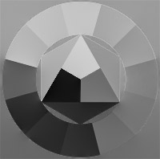
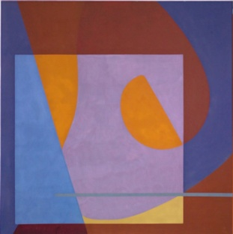
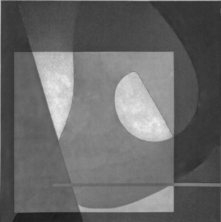
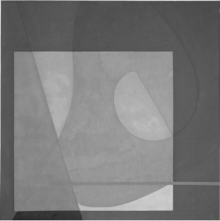
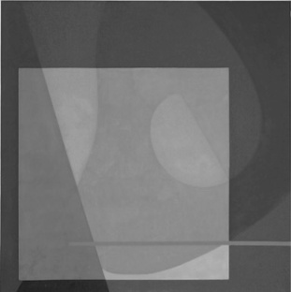
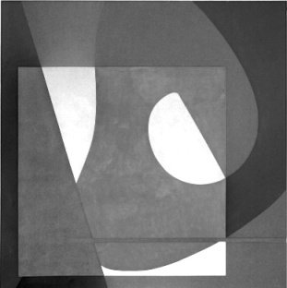





Experiment Results
Comparison with previous works - Interactive
Original
Ours
[Kim et al. 2009]
[Gooch et al. 2005]
[Neumann et al. 2007]

Slide 21














Experiment Results
Comparison with previous works - Interactive
Original
Ours
[Kim et al. 2009]
[Gooch et al. 2005]
[Neumann et al. 2007]

Slide 22

Experiment Results
Comparison with previous works: interactive and automatic

Slide 23

Evaluation
Comparison with 8 previous works, on 24 different input images
Evaluated by both MSSIM and PSNR
Sorting and scoring according to MSSIM / PSNR values
Original
Ours result
CIE Y
[Lu et al. 2012]
[Kim et al. 2009]
[Grundland, et al. 2007]
[Gooch et al. 2005]
[Neumann et al. 2007]
[Smith et al. 2008]
[Rasche et al. 2005]

Slide 24




Evaluation
Our method:
The highest average score and “No.1-hit” rate for MSSIM
The highest “No.1-hit” rate and 2nd highest average score for PSNR
Average score
“No.1-hit” rate

Slide 25
Conclusion & Future Work
Gradient domain color-to-gray conversion
Controlled chromatic enhancement to the luminance gradient
Salience-preserving
No visible grayscale distortion
Correct color ordering for isoluminance images
Automatically deciding of the parameters
Outstanding results in contrast with the prior works
The optimizing efficiency need to be improved

Slide 26
Thank You!
E-mail: feng_jie@pku.edu.cn

