Slide 1
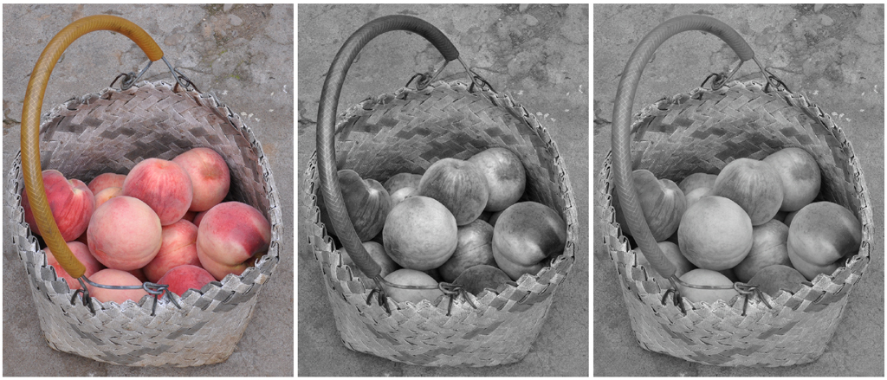
Gradient Domain Salience-preserving Color-to-gray Conversion
Bingfeng Zhou and Jie Feng
Institute of Computer Science and Technology
Peking University
Beijing, China

Slide 2
Outline
Motivation & related works
Color-difference-based Color-to-gray Conversion
Artifact Removal
Color Ordering for Isoluminance Image
Experimental results
Conclusion & future work

Slide 3
Motivation & Related work
Color-to-grayscale conversion for digital color images
Widely used in black-and-white printing, video, animation, etc.
Preserving features in conversion
Many problems to solve
Current color-to-gray conversion methods:
Linear combination of original color channels [Ohta and Robertson2005]
Lack the color discriminability for isoluminant colors
Global optimization algorithms [Gooch et al. 2005; Kim et al. 2009]
Very time-consuming
Local feature enhancement algorithms [Neumann et al. 2007; Smith et al. 2008]
Low execution efficiency
Gray-scale distortion

Slide 4
Motivation & Related work
Ideal color-to-gray conversion algorithm
Coincide with the luminance vision of human eyes
L component of CIELAB (CIE 1976 (L*a*b*))
Keep discriminability of isoluminance colors
No artifacts be introduced into the resulting grayscale image
e.g. “halo effect” generated by a Poisson Equation Solver
Our method
Color-difference-based color-to-gray conversion
Solves the problem in the gradient domain
Enhancing luminance difference with a modulated chromatic difference
Contributions
Preserving salience of the original color image
Minimizing grayscale distortion
Keep correct color ordering for isoluminance colors

Slide 5
Gradient Domain Image Processing
For a grayscale image I :
A discretization of a continuous function I(x,y) in R²
Given the gradient ∇I, the original image I can be reconstruct by a PDE solver, e.g. a Poisson equation solver (PES)
For color-to-gray conversion, I may be the luminance component L of a color image C in CIELAB
By modifying ∇I, a different image can be obtained for certain purpose [Fattal et al. 2002; Perez et al. 2003; McCann and Pollard 2008]

Slide 6
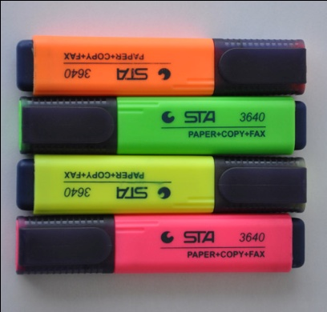
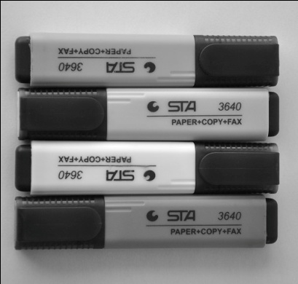
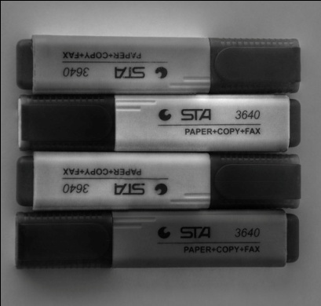
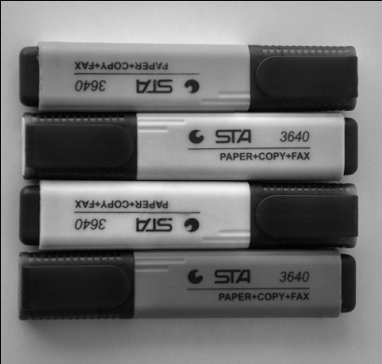
The Measurement of Color Difference
Using only L component in grayscale image reconstruction
Does not coincide with the color difference that human eyes perceive
Define color difference with Euclidean distance in CIELAB
More color difference can be successfully preserved
Perceptible grayscale distortion may occur at the same time
Original
L of CIELAB
Grayscale distortion using ∆E
Modulated chromatic difference

Slide 7
The Measurement of Color Difference
Our improvement:
Add a modulation function A(·) to the chromatic difference
Grayscale distortion can be minimized
Original
L of CIELAB
Grayscale distortion using ∆ E
Using modulated color difference

Slide 8
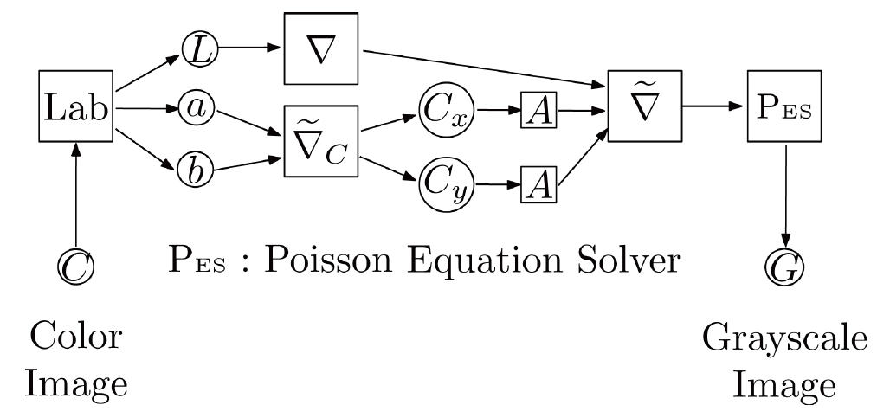
Color-difference-based Color-to-gray Conversion
A new color-to-gray conversion framework
Based on the modulated chromatic color difference
The input color image C is composed of
L, a, b channels of the CIELAB model
A luminance gradient
A chromatic gradient

Slide 9
Color-difference-based Color-to-gray Conversion
The gradient field of C: is calculated as:
A(·): modulation function for color differences, for artifact removal
sign(·): sign function of the gradient, for determining the color ordering
Grayscale image G is reconstructed by a PES

Slide 10
Artifact Removal
Creating new images with PES
Common problem: the existence of artifacts
Cause grayscale distortion in color-to-grayscale conversion
Employs multi-scale schema [Fattal et al. 2002]
Removes the inconsistency of the gradient field [Neumann et al. 2007]
Our solution
Single-scale method, fast and efficient
Selectively attenuate the gradient enhancement by a modulation function A(·)

Slide 11
Artifact Removal
Modulation function
Scales down the input signal by a scaling function A₀(·)
Works only on chromatic difference C_{x} and C_{y}
Enhancement to the luminance difference is always valid for any β≠0
Larger value of γ will preserve more high chromatic differences

Slide 12
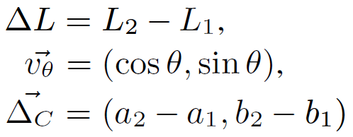
Color Ordering for Isoluminance Image
Isoluminance colors
Difficult to determine the ordering to preserve their difference in the grayscale image
Defining sign function for the gradient field
Defined as the sign of the luminance difference
Do not work for pixels with equal luminance
Our sign function sign(·)
For isoluminance colors (L₁, a₁, b₁) and (L₂, a₂, b₂)
: affecting strength of the chromatic difference
: defines a direction in a-b plane

Slide 13
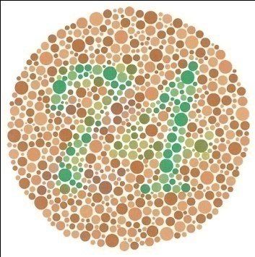
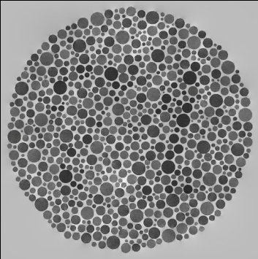
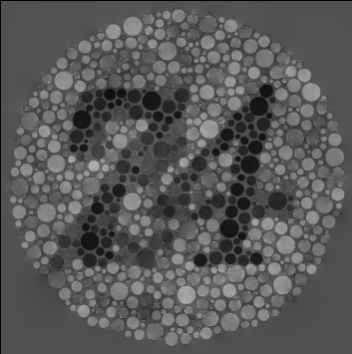
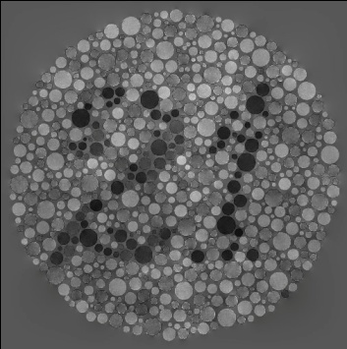
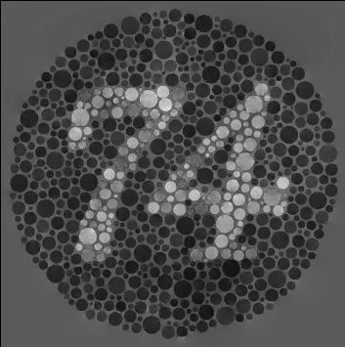
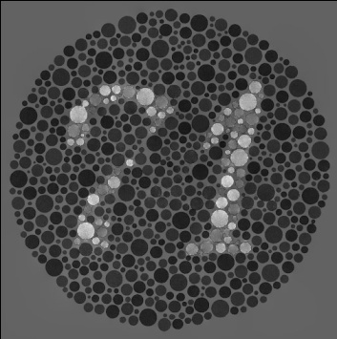
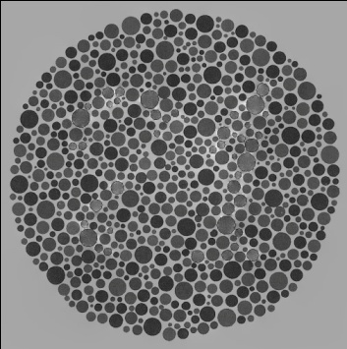
Color Ordering for Isoluminance Image
Example
A color blindness testing chart: chromatic color differences larger then luminance difference
Sign function with different θ reveals different pattern
Original
L in CIELAB
θ=0˚
θ=45˚
θ=90˚
θ=135˚
θ=180˚
θ=225˚

Slide 14
Experimental Results
Implementation
Input RGB image → CIEXYZ → CIELAB
RGB color: PAL-RGB; reference white: D₆₅
Efficiency
Using a PES with linear time complexity [Press et al. 1992]
Steady execution speed
2 seconds per mega pixel (1024×1024 pixels in RGB)
Intel Core Dou CPU 2.2GHz and 2GB memory
Insensitive to the size of the input image
Quickly find optimal parameters on a low-resolution version

Slide 15
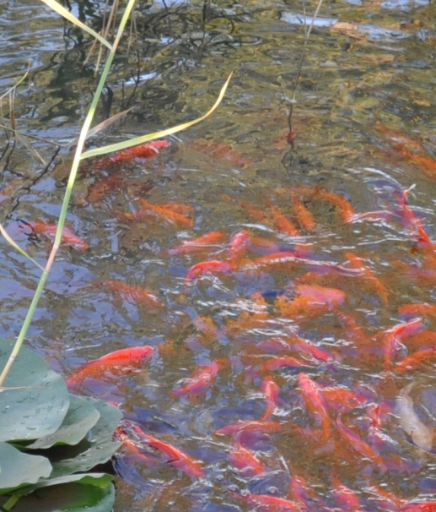
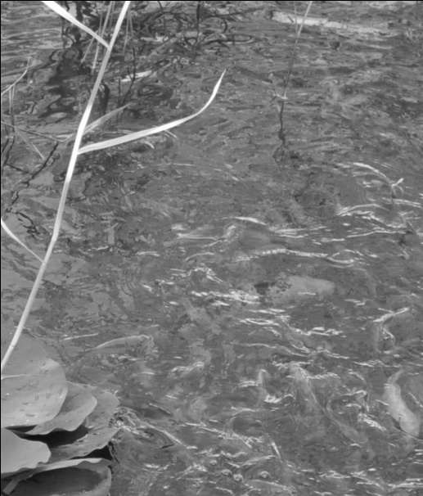
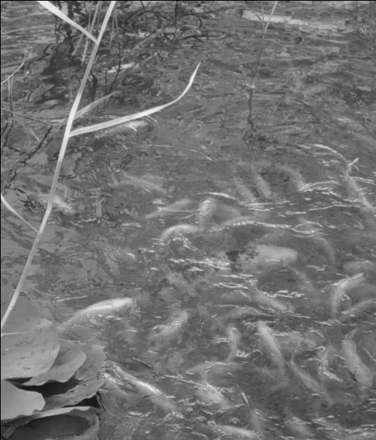
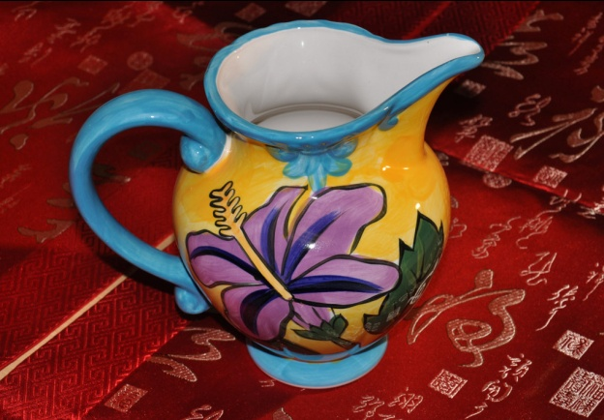
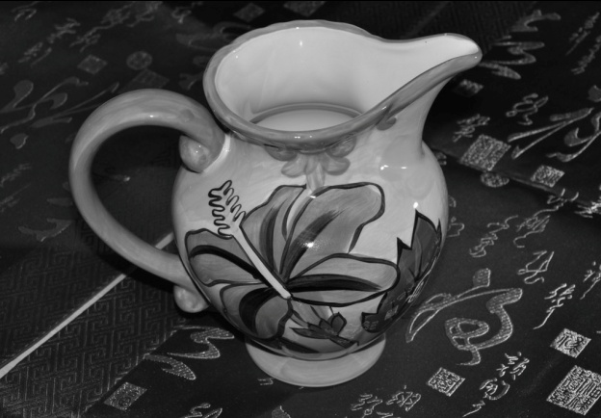
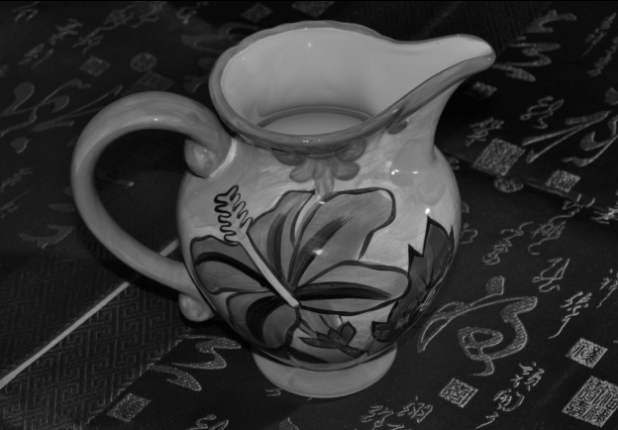
Experimental Results
Salience preserving
Satisfying salience-preserving ability
Preserve more details, visually closer to the original color image
Original
L of CIELAB
Our result
Original
L of CIELAB
Our result

Slide 16
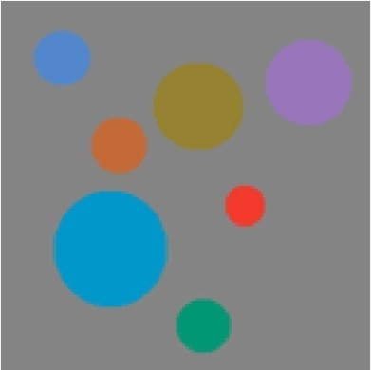
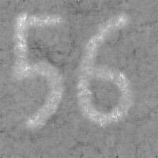
Experimental Results
Color discriminability
Perfect color discriminability and ordering for both continuous color and discrete color
Original
L of CIELAB
Our result
Original
L of CIELAB
Our result

Slide 17
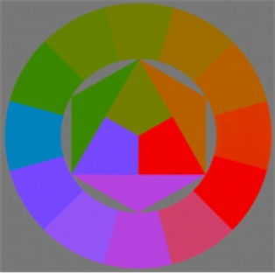
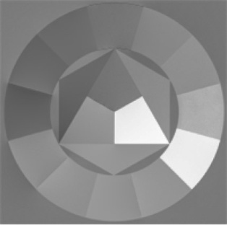
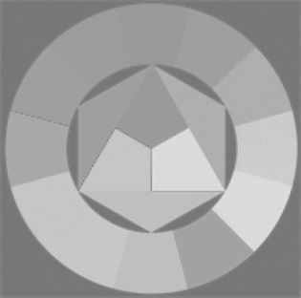
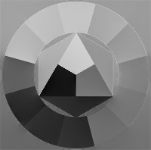
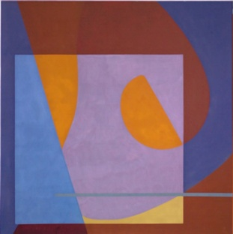
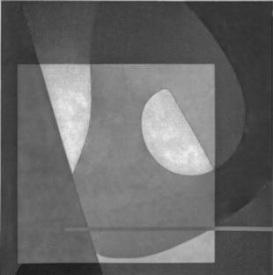
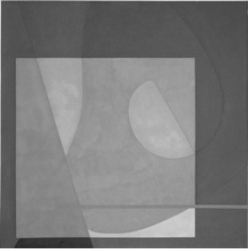
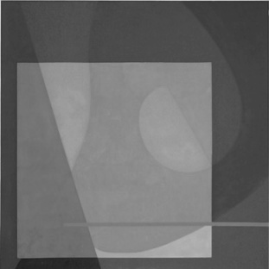
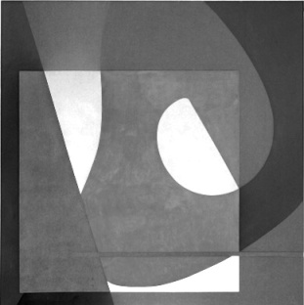
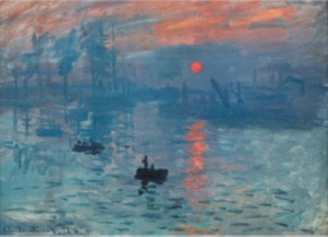
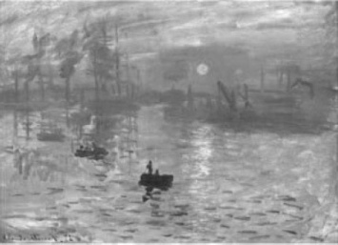
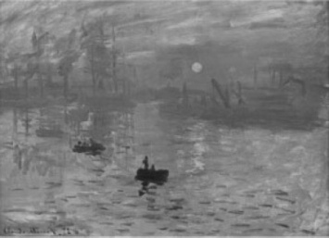
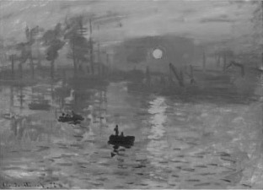
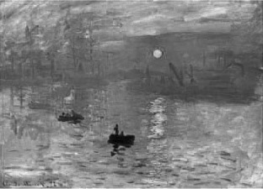
Experimental Results
Comparison with previous works
Original
Ours
[Kim et al. 2009]
[Gooch et al. 2005]
[Neumann et al. 2007]

Slide 18
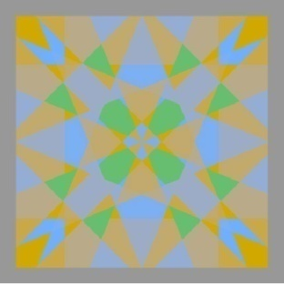
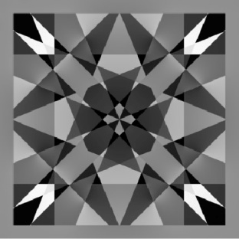
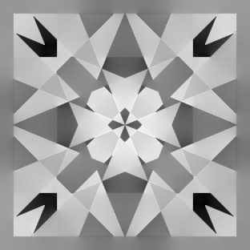
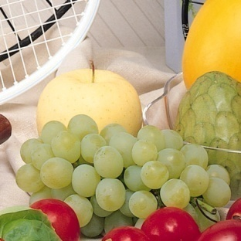
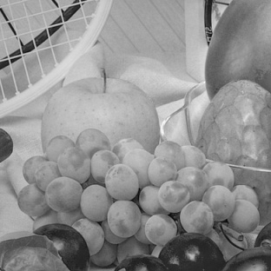
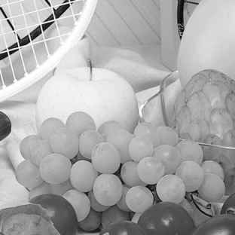
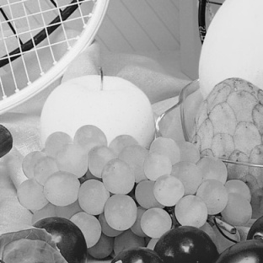
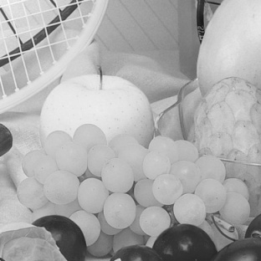
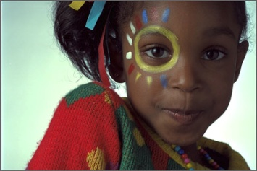
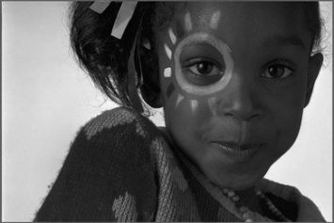
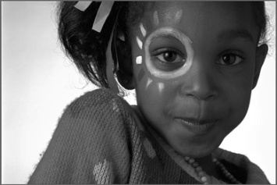
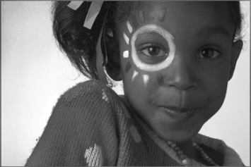
Experimental Results
Comparison with previous works
Original
Ours
[Kim et al. 2009]
[Gooch et al. 2005]
[Neumann et al. 2007]

Slide 19
Conclusion
Gradient domain color-to-gray conversion
Controlled chromatic enhancement to the luminance
Salience-preserving
No visible grayscale distortion
Interactively choosing of the optimal parameters
Future work
Automatically deciding of the parameters
4-parameter optimization (β, γ, α and θ)

